Slide 1
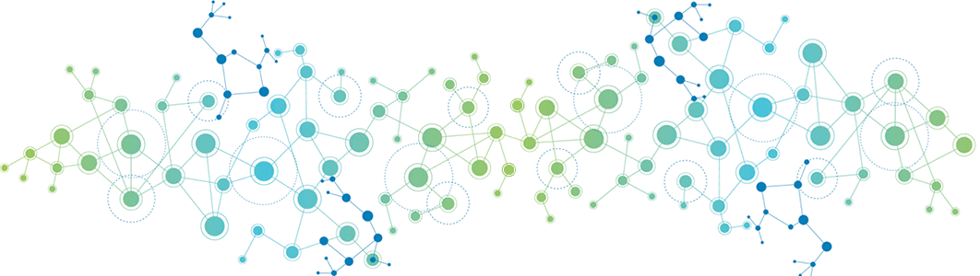

Deep Learning
Gradient Descent Algorithm

Slide 2
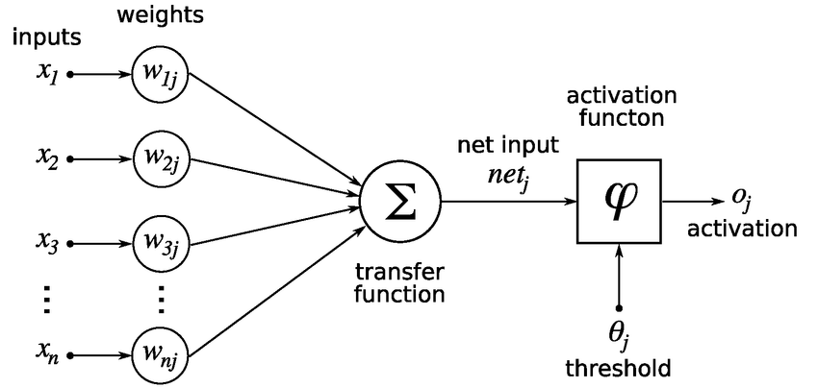
What is Gradient Descent?
Gradient descent is the optimizer that we used to minimize the loss function which helps in improving the model performance and accuracy.
8
4
9
21/8 = 2.6
21/4 = 5.2
21
21/9 = 2.3

Slide 3
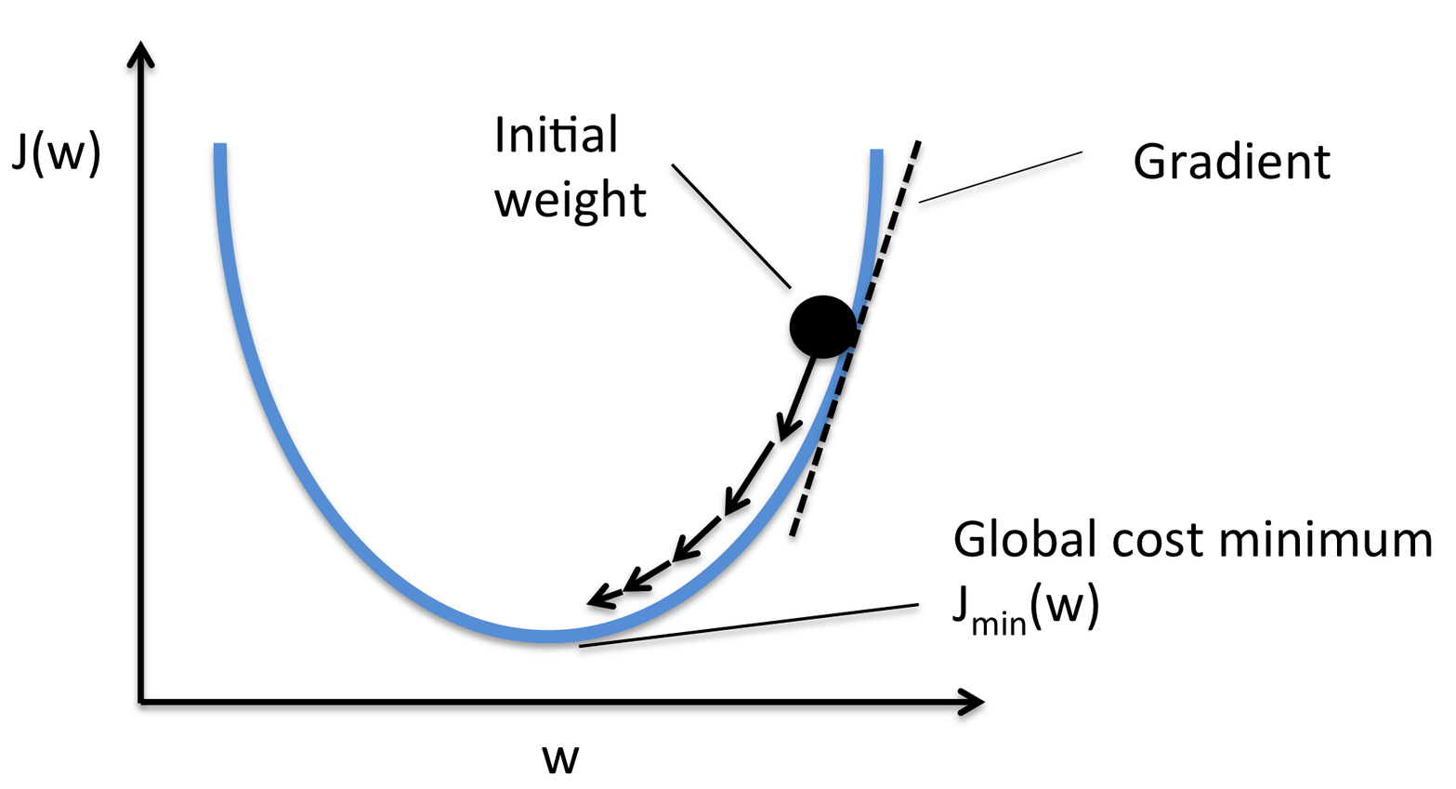
What is Gradient Descent?
F(x) = x² + 3x + 2
F’(x) = 2x + 3
m1 ​= m0​−α∇f(x0​)

Slide 4
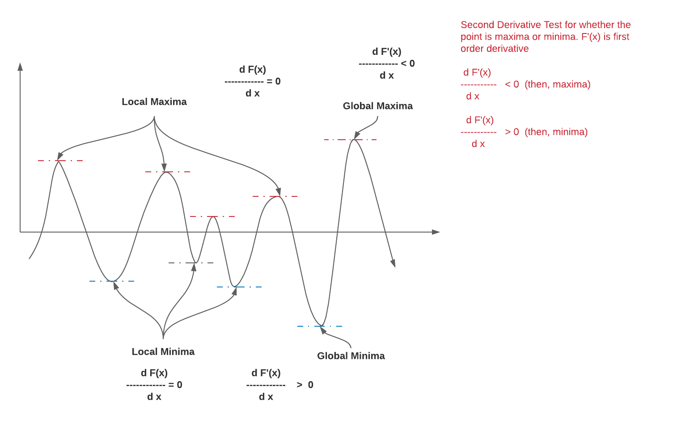
Local Minima?

Slide 5
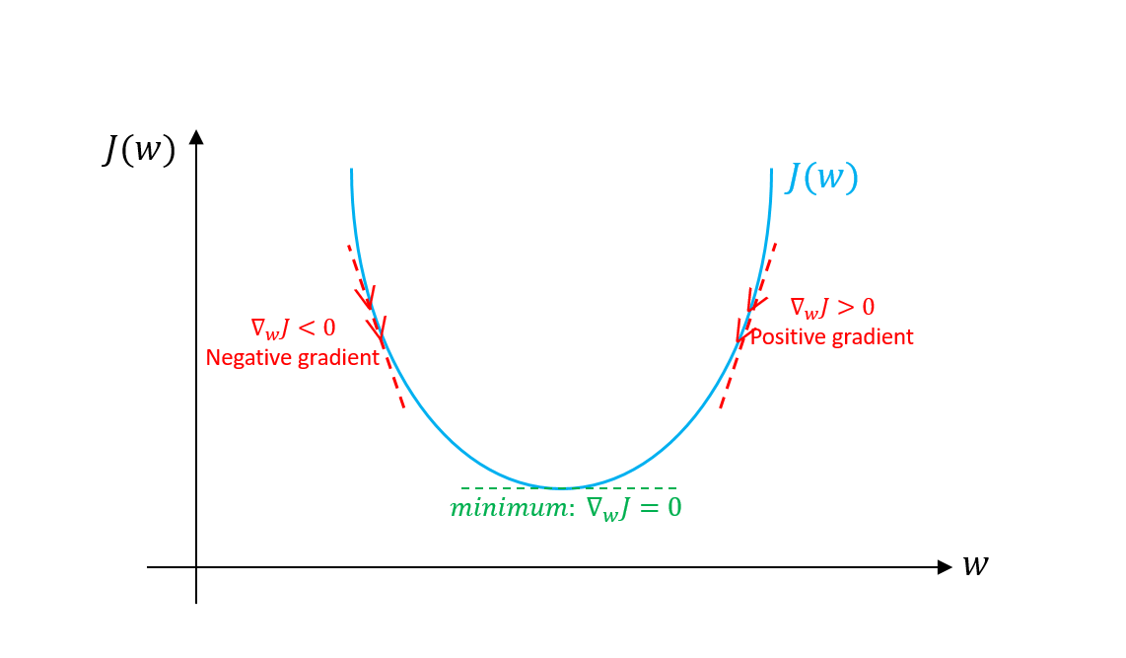
Why we called Gradient Descent?
w1 ​= w0​−α∇f(x0​)
J(w) = w² + 3w + 2
J’(w) = 2w + 3
J’(-2) = -1
J(w) = w² + 3w + 2
J’(w) = 2w + 3
J’(2) = 7
-2 0 2

Slide 6
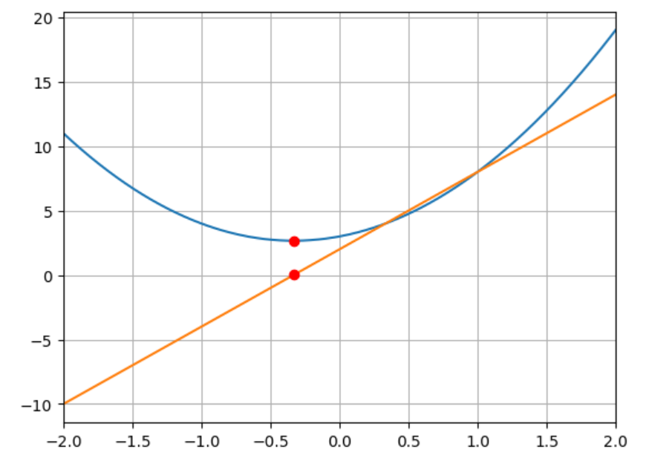
Gradient Descent Algorithm
Initialize random guess for minima
Training iterations Loop
Calculate derivative for guessed minima
Update guessed minima
Minima = Minima - (Learning Rate * Gradient)

